Slide 1
Module 1: Multi-Agent Architectures (The Orchestrator)
Goal: Mastering the orchestration of multiple specialized AI agents to handle complex business requests.
Core Philosophy: Move from single-model prompting to Role-Based Agent Design, where specific personas have unique constraints and domain knowledge.

Slide 2
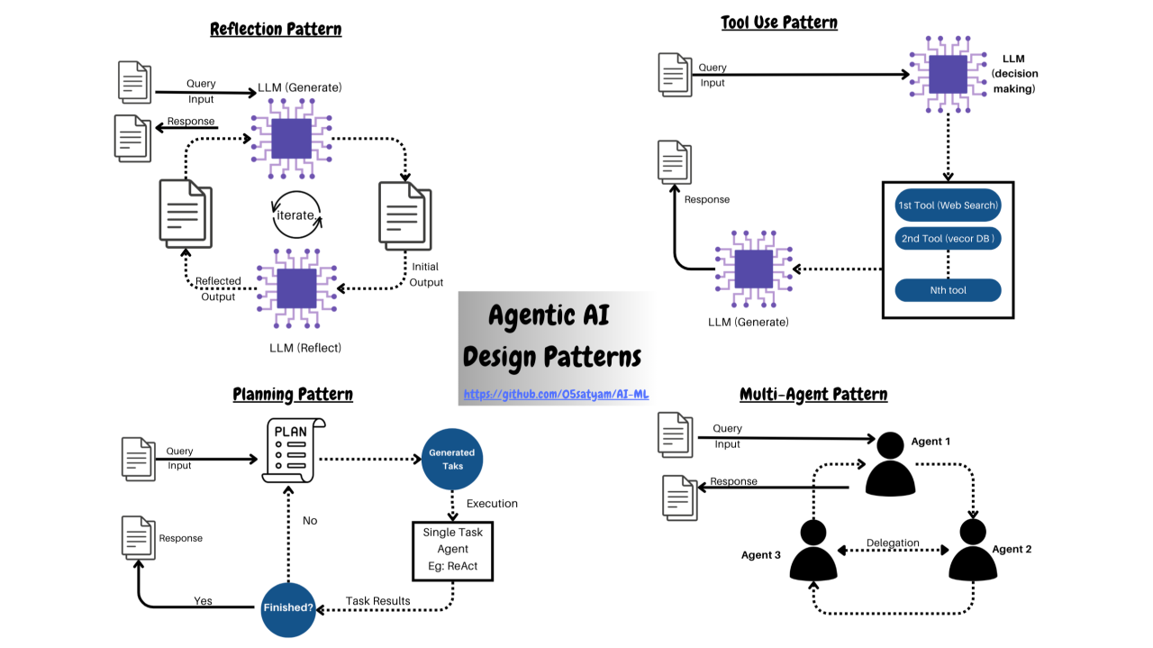
Architectural Patterns
Autonomous Task Decomposition: Engineering "Manager" agents that break a complex goal into a multi-step execution plan.
Handoff Protocols: Establishing how agents transfer structured data (JSON) and maintain "Shared Memory" across long workflows.
Flow Types: Comparing Hierarchical systems (agents reporting to a supervisor) vs. Collaborative systems (agents negotiating as peers).

Slide 3
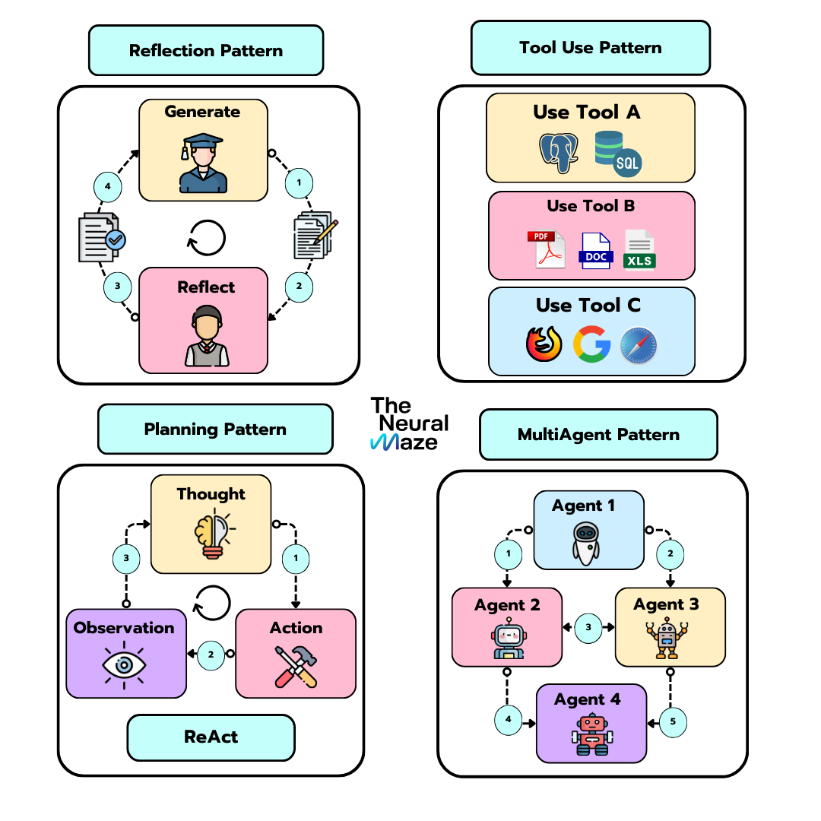
The Reflexion Pattern
Self-Correction Loops: Building loops where a second agent reviews and critiques the first agent's output before finalization.
Quality Auditing: Using specialized "Quality Auditor" personas to enforce standards and reduce hallucinations.
Task 1 Deliverable: A functional autonomous team consisting of a Researcher, Writer, and Manager.

